Slide 1


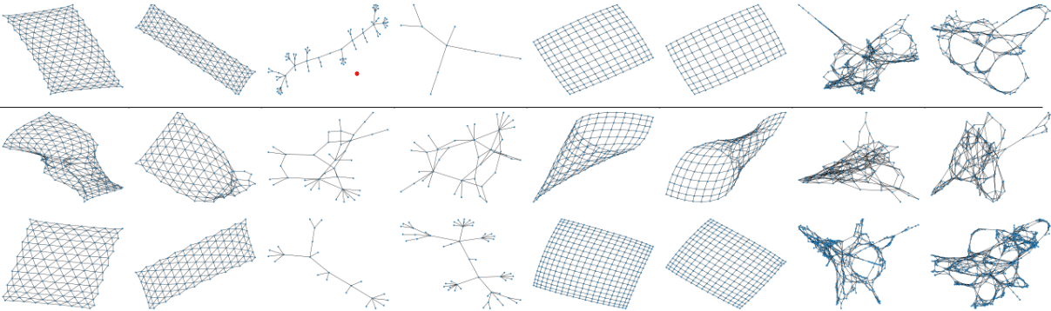
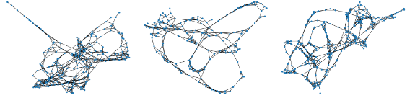

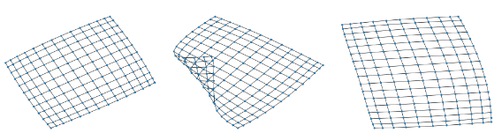


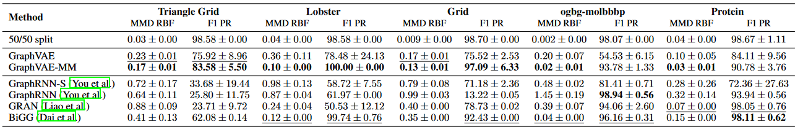
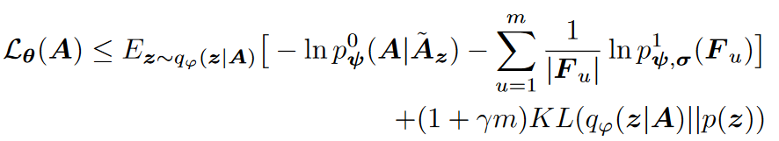
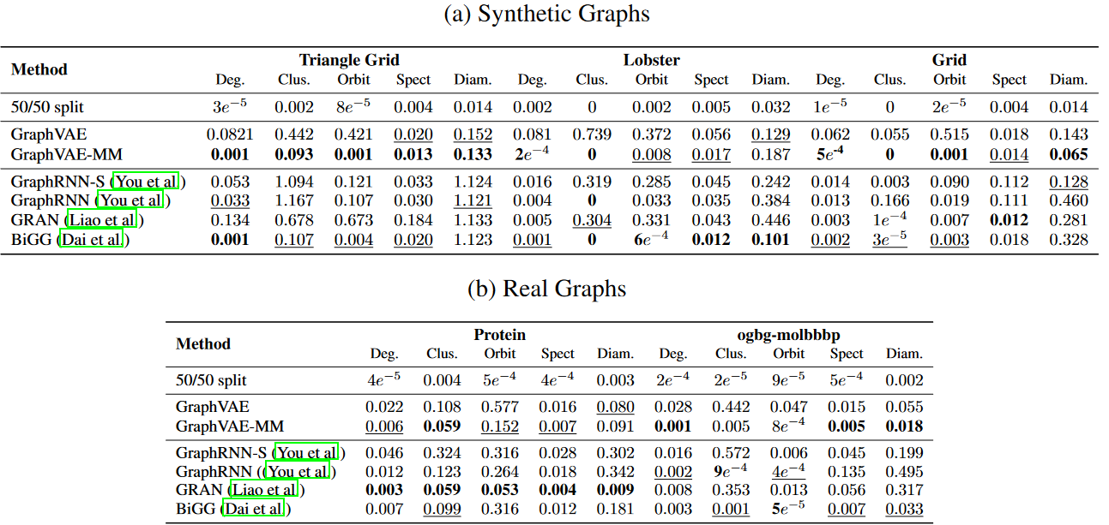
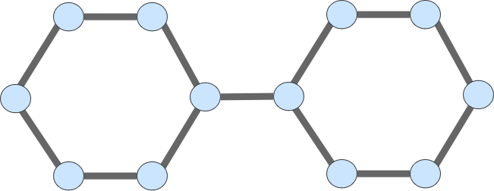
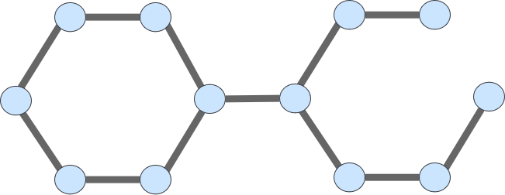
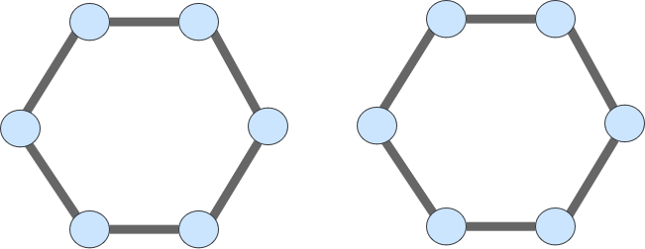
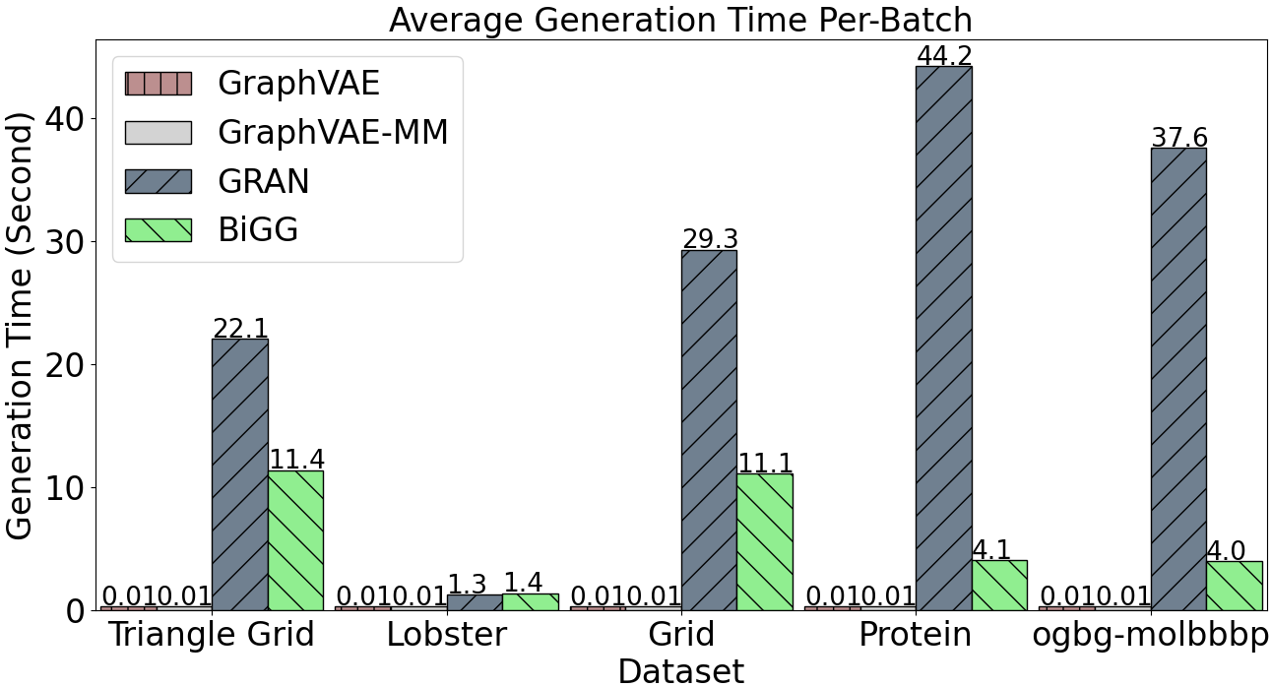
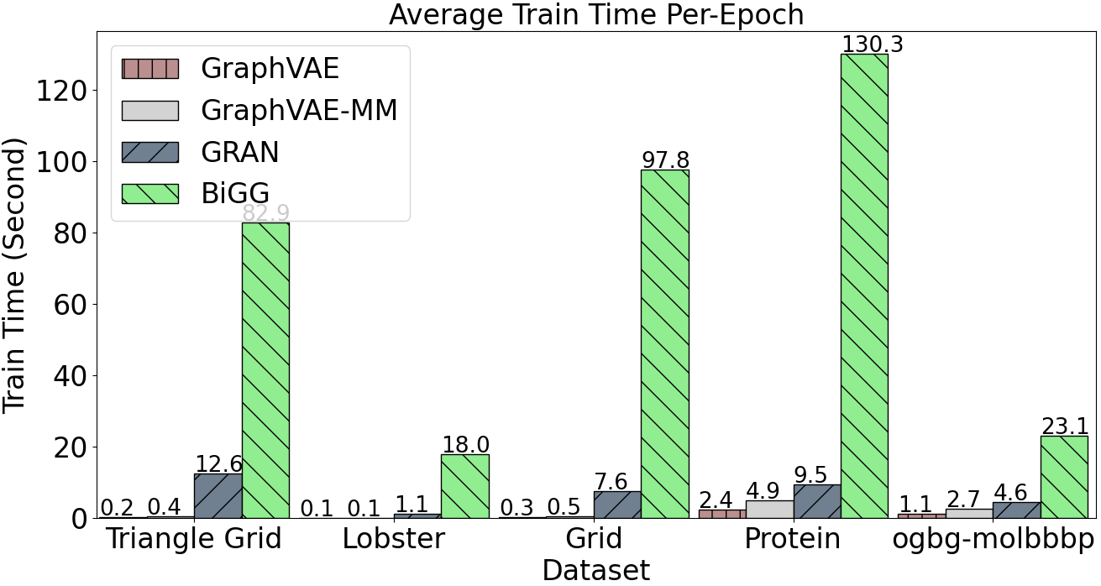
Micro and Macro Level Graph Modeling for Graph Variational Auto-Encoders
Kiarash Zahirnia, Oliver Schulte, Parmis Naddaf, Ke Li
Graph Generation
Micro-macro (MM) Modeling:
Qualitative Evaluation
Given a set of observed graphs G = {𝒢₁, ...𝒢_{S} } sampled from data distribution p(G), the goal of learning generative models for graphs is to learn a generative model p_{θ}(G) which is similar to p(G).
This paper focus on the realism of generated graphs.
A principled probabilistic framework that incorporates both local (Micro) and global (Macro) graph properties.
Assuming a predefined finite set of graph global statistics/properties, calculated by φ₁(), …, φ_{m}() micro-macro loss is of the form:
Triangle Grid
Lobster
Grid
Protein
Test
L⁰ : micro loss.
L¹ : macro loss.
A: training sample.
GraphVAE
F_{u}: random variable defined by φ_{u}(A).
𝜸: hyperparameter.
Samples from Protein dataset (real data).
GraphVAE
-MM
GraphVAE-MM Objective
This paper works with negative log-likelihood losses:
GraphVAE–MM achieves much better visual match than GraphVAE.
Quantitative Evaluation (GNN-based evaluation metrics Thompson et al 2022)
Samples from Grid dataset (synthetic benchmark).
Deep Graph Generative Models (GGM)s fall into 2 categories (Hamilton 2020):
1) All-at-once Models
2) Autoregressive Models
Current all-at-once methods are faster, but tend to generate less realistic graphs.
Ã_{z}: probabilistic adjacency matrix computed as a function of graph embedding z.
|F_{u}|: dimensionality of F_{u}.
Global and Local Graph Properties
Approximating with variational Lower bound,
MMD RBF and F1 PR capture the reality and diversity of generated graphs, respectively.
Impact on GraphVAE. MM modeling provides a large improvement in the realism and diversity of graphs generated by a GraphVAE architecture.
GraphVAE-MM vs. Benchmark GGMs. Micro-macro (MM) modeling greatly improved the GraphVAE, to match or exceed that of benchmark models.
It is common in graph analysis to distinguish two levels of information:
1) Local node-level properties; e.g degree of a specific node.
2) Global graph-level properties; e.g degree distribution.
Deep GGMs are trained with an objective based on local properties.
Local properties do not model different edge importance in the graph global structure.
Example:
By approximating with variational Lower bound we have:
Experiments
GraphVAE (Dai et al 2018) architecture: All-at-once model with fast training and generation time for medium-sized graphs.
GraphVAE-MM: Uses e micro-macro objective to improve GraphVAE.
To evaluate the effect of MM modeling, we follow a AB design: utilize GraphVAE architecture as is and change only the training objective.
Quantitative Evaluation (statistic-based evaluation metrics O’Bray et al 2022)
In our experiments, we utilize 3 default global graph-level properties:
Degree histogram
Number of triangles
S-Step transition probability for S=2,...,5.
Original Graph
Generated Graph 1
Generated Graph 2
The two right graphs score the same in terms of the number of reconstructed edges from the original graph, a node-level score.
But Graph 1 is structurally more similar to the Original Graph, at the global graph-level.
Generation and Train Time
References
Martin Simonovsky et al. (2018). “GraphVAE: Towards generation of small graphs using variational autoencoders”. ICANN.
Jiaxuan You et al. (2018). “GraphRNN: Generating realistic graphs with deep auto-regressive models”. ICLR.
Renjie Liao et al. (2019). “Efficient graph generation with graph recurrent attention networks”. NeurIPS.
Hanjun Dai et al. (2020). “Scalable deep generative modeling for sparse graphs”. ICML.
William L Hamilton. (2020). “Graph representation learning”. Synthesis Lectures on Artificial Intelligence and Machine Learning.
Rylee Thompson et al. (2022). “On evaluation metrics for graph generative models”. ICLR.
Leslie O’Bray et al. (2022). “Evaluation metrics for graph generative models: Problems, pitfalls, and practical solutions”. ICLR.
MM modeling maintains the GraphVAE generation speed advantage.
Statistic-based evaluation of MM modeling shows MM modeling improves the reality of graphs generated by GraphVAE, up to 2 orders of magnitude on five benchmark datasets.

